Slide 1
Ethical Impacts of AI generated images using StyleGAN 2
Group 9785-S1-08
Khoa Le, Ricky Hudson, Uyen Nguyen, Arjun Sharma
Sponsor: Dr Masoud Mohammadian

Slide 2
Introduction to StyleGAN and StyleGAN 2
StyleGAN or GAN (Generative Adversarial Networks) is a theory in machine learning developed in 2014 by Nvidia.
Main purpose is to generate realistic artificial images
We are using StyleGAN 2 as it made some key improvements regarding detail of generated images and the speed of training.
StyleGAN 3 which make further improvements with the detail but requires a stronger GPU to train the images.

Slide 3
Google Colab
Allows access to enterprise level GPU which are better at running StyleGAN to produce results quicker.
Upgrade is required to Google Colab Pro, however, the $15 per month cost is very low compared to the outright cost of the enterprise GPU
There is still a limit of 24 hours runtime for a program, up from 12 hours of the free version
Features | Tesla T4 | Geforce GTX 1060
RAM | 16 GB GDDR6 | 6 GB GDDR5
Effective Memory Speed | 10000 MHz | 8008 MHz
Maximum Memory Bandwidth | 320 GB/s | 192.2 GB/s
Price | $3,500 | $415

Slide 4




Real Or Fake?

Slide 5
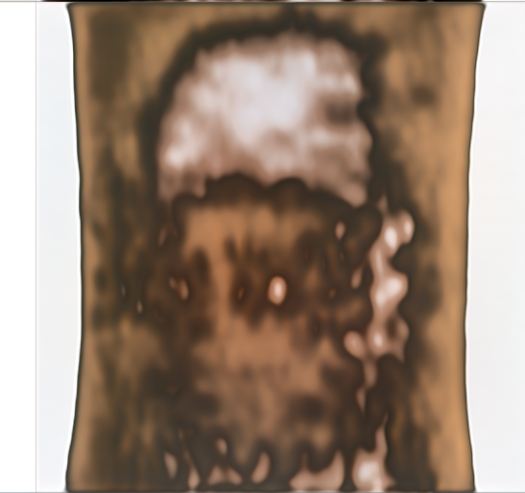
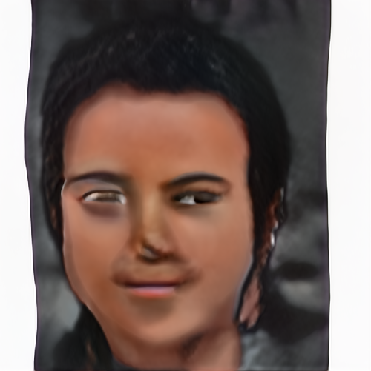
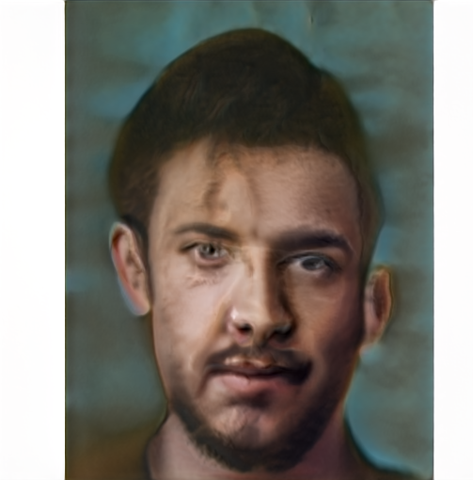
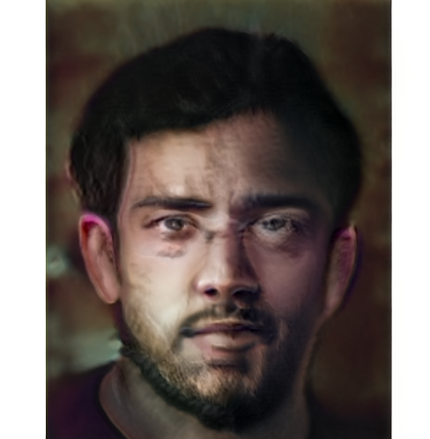
Generating Fake People
200 images of people used – Different face shapes, ethnicity, age, hair, and eye colour
Image quantity and quality matters
How do you spot a fake?
Which face is real?
This person does not exist
Progress of AI training of the human face after 25, 50, 220, 285 iteration

Slide 6
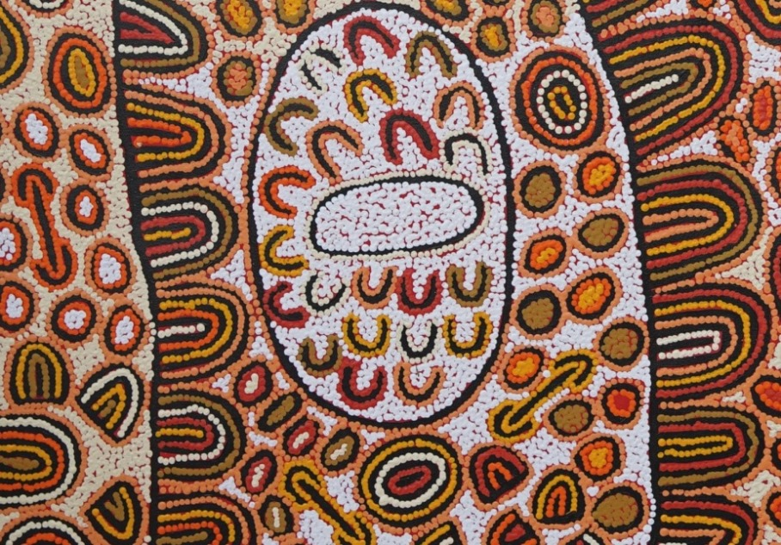
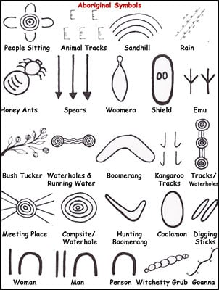
Aboriginal art patterns
A real Aboriginal painting with meaningful patterns
The U shape is for people sitting on the earth.
The implements beside them is to differentiate woman and men.
The boomerang is placed with the man as his hunting tools.
People gather around the circle or a set of concentric circles
The lines illustrate the movement of people.
Depending on the designs being painted, these symbols will have different meanings.
The concentric hole can be campsite on one design, and the same one can be water hole in another design.
Therefore, a combination of those patterns will represent different stories behind every paintings.

Slide 7
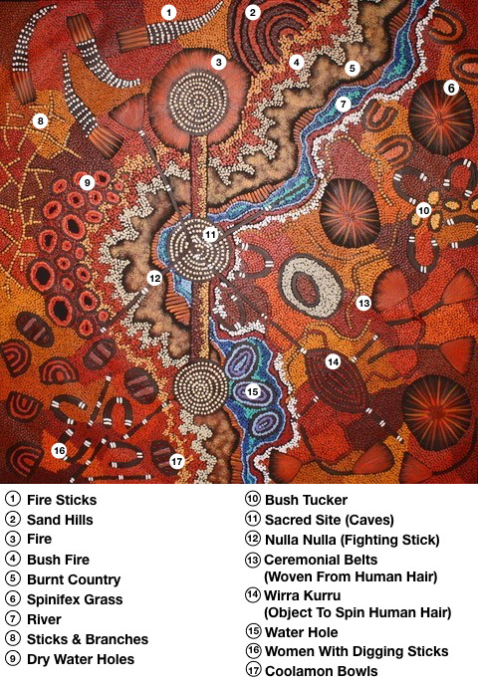
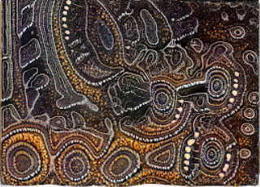
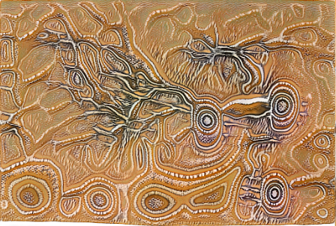
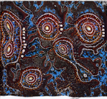
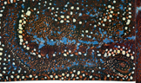
A comparison between the generated and real aboriginal arts
Replicate the concentric holes (Camp site or Water holes)
and dot points (symbols to hide from the White man) in
Aboriginal Art.
Resemble the river lines

Slide 8
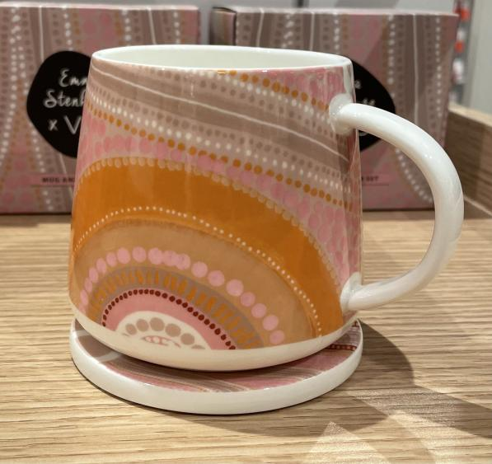
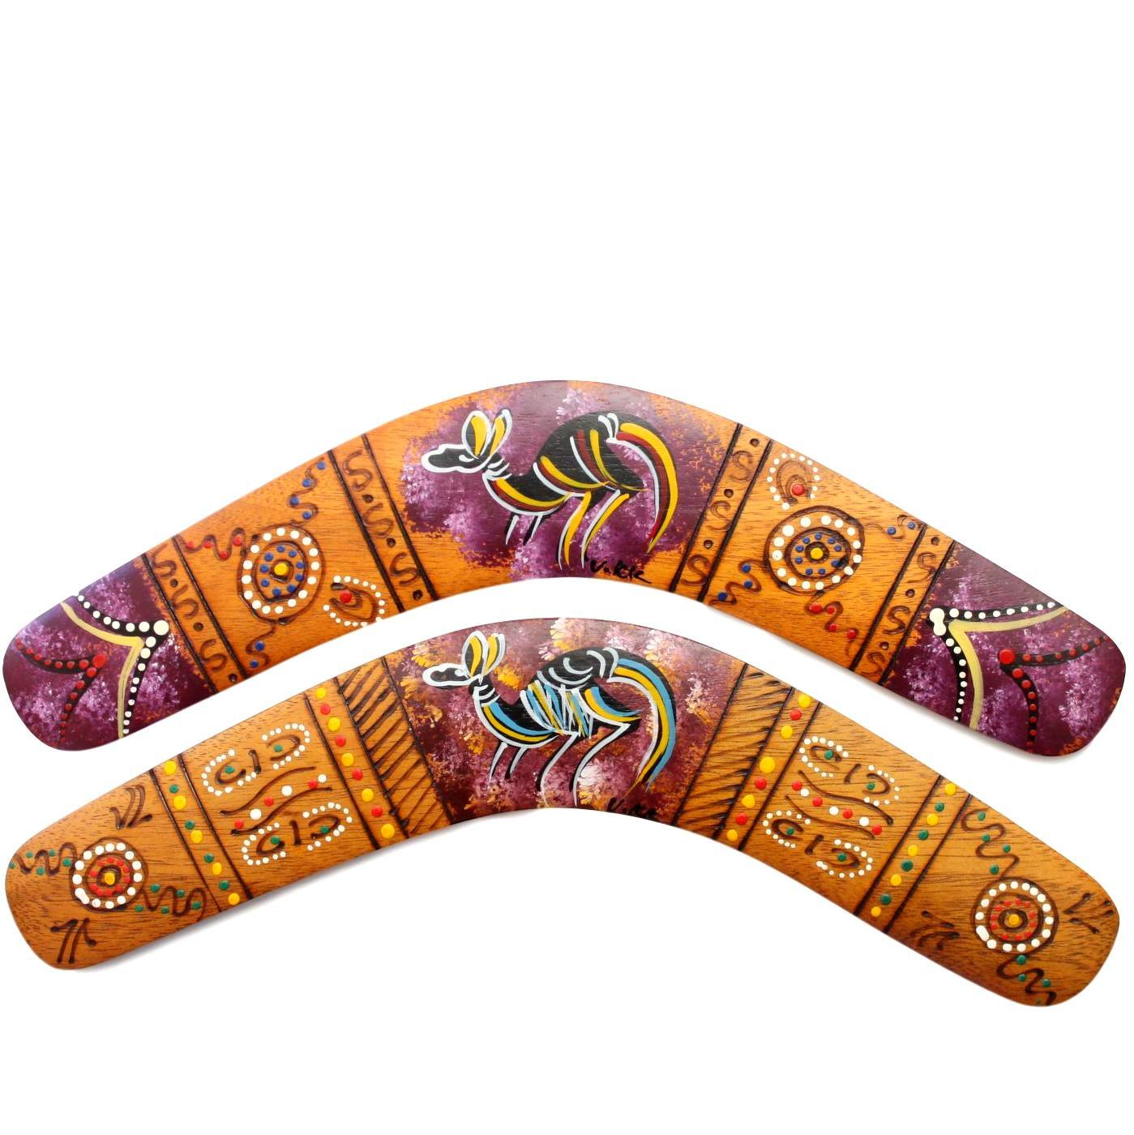
How generated arts can be used by people
Ethical concerns
Copyrights owner
It was hard to identify the actual artists who make art products
Cultural values
The tourists can be fooled by the generated arts without
realizing the cultural values
Art sold on digital market are sold by their looks rather than values
Intelligence assets
StyleGAN can be utilized for producing Aboriginal
artworks in large volume and hence generates
considerable profits for the owners without much
knowledges in coding.
Artist efforts and intelligence are used without awareness
Backstories ignorance
The implied meaning and design of a painting are ignored
Authentic arts or computer-generated products?
Souvenir products or daily products can be made
from Aboriginal Arts
Arts which can be easily generated by technology by any
people without meanings and purposes might not be considered authentic arts
An easy way to make money

Slide 9
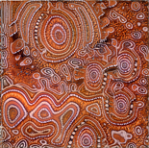
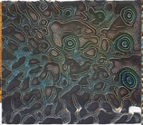
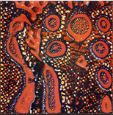
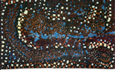
Questions?

Slide 10
Contact Details
Ricky Hudson – u3201054@uni.canberra.edu.au
Khoa Le – u3201054@uni.canberra.edu.au
Uyen Nguyen – u3206201@uni.canberra.edu.au
Arjun Sharma - u3204935@uni.canberra.edu.au

Slide 11
References
Training Nvidia StyleGAN2 under Colab Free and Colab Pro tricks (12/04/2021) Youtube video, added by Jeff Heaton [Online]. Available at: https://www.youtube.com/watch?v=L3JLzoe-dJU
Analytics Vidhya. 2022. StyleGAN Explained in Less Than Five Minutes - Analytics Vidhya. [ONLINE] Available at: https://www.analyticsvidhya.com/blog/2021/05/stylegan-explained-in-less-than-five-minutes/. [Accessed 11 April 2022].
Japingka Aboriginal Art Gallery (2019). Australian Aboriginal Art Symbols & Their Meanings - Japingka Gallery. [online] Japingka Aboriginal Art Gallery. Available at: https://japingkaaboriginalart.com/articles/aboriginal-art-symbols/.
Aboriginal Bark Paintings. (2019). Aboriginal art meaning | Meaning of Aboriginal art | Churinga | Tjuringa. [online] Available at: https://www.aboriginal-bark-paintings.com/aboriginal-art-meaning/.
Artlandish (2018). The Amazing Story of Aboriginal Art. [online] Artlandish Aboriginal Art Gallery. Available at: https://www.aboriginal-art-australia.com/aboriginal-art-library/the-story-of-aboriginal-art/.
Random Face Generator. (2022). This Person Does Not Exist. [Online] Accessed 14/04/2022. Available at https://this-person-does-not-exist.com/en

